Slide 1
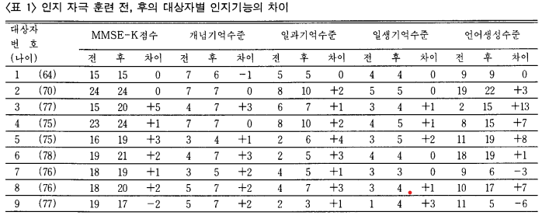
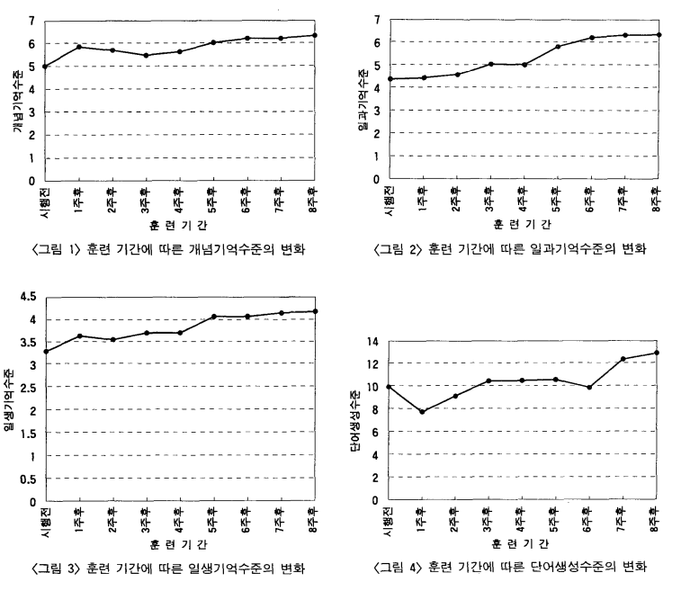
Cognitive stimulation training medical game
to delay the progression of dementia
Cho kangsik, Kang Jeongmu , Kim minjae, Ha Ideun
Background
Results
Dementia refers to a complex syndrome in which a normally mature brain is damaged or destroyed by acquired trauma, illness, or other external factors, resulting in a general decline in cognitive function, learning, language, and higher mental functions. According to the World Health Organization (WHO), there are about 50 million people with dementia worldwide, and this number is estimated to more than triple to 152 million by 2050. In Korea, as of 2018, the estimated number of dementia patients among the elderly population aged 65 and over was 748,945 (average dementia prevalence rate of 10.0%), and it is projected to surpass 1 million in 2024, 2 million in 2039, and exceed 3 million by 2050.
,
<Table 1>Differences in cognitive function among individuals before and after cognitive stimulation training.
Objectives
Basic medication therapy and simple and enjoyable games can be used to expect the effects of cognitive stimulation training for elderly patients with dementia. This can promote positive interaction between IT and medical fields, and help alleviate the progression of dementia in patients. In addition, visualizing rankings in games can activate communities of elderly patients with dementia and also help families and caregivers of dementia patients.
Changes in conceptual memory retention over the course of training
Changes in working memory capacity over the course of training
Methods
Changes in episodic memory retention over the course of training
Changes in word generation level over the course of training
In augmented reality games, patients' brains will be stimulated by giving them missions to find given objects within a specific space for a set amount of time. Trained models using image classification and object detection in Unity environment will provide immediate rewards. If patients correctly solve the problems presented in the game, they will receive coins as a reward, which can be collected and exchanged for actual goods, creating a program with a real-life incentive system.
Dementia is a disease that refers to a decline in cognitive and higher mental function, affecting not only the patient but also their family, loved ones, and society at large. As the prevalence of dementia increases not only in Korea but also globally, there is a growing need for new programs that can aid in its treatment. However, there is currently no complete cure for dementia. Therefore, our team focused on developing a game that could help slow down the progression of dementia.
The game is played in augmented reality and involves completing missions to find specific objects. It is designed to be easy and enjoyable for dementia patients, tailored to their cognitive abilities and aimed at training their cognitive functions. As the use of augmented reality may be challenging for some dementia patients depending on their age, the usage time is adjusted accordingly.
Results
As shown in the first table, cognitive stimulation training has shown significant results in conceptual memory, working memory, episodic memory, and particularly in language generation. Therefore, it can be expected that a similar level of improvement in cognitive function can be achieved for individuals with dementia through continued cognitive stimulation training using the developed augmented reality game.
The second graph shows that as the duration of cognitive stimulation training increases, cognitive function improves across all age groups in older adults. Therefore, it can be anticipated that patients will show improvement in all areas of cognitive function, including conceptual memory, working memory, episodic memory, and language generation through the program being developed.
Thus, cognitive stimulation can potentially delay the progression of dementia.
References
Kim, Jung soon[1992]. The Effect of Cognitive Stimulation Training on Elderly Persons with Dementia. Journal of Community Nursing Research, Vol. 8, No. 2
[Medical News] The era of one million dementia patients is coming... Preparations needed

